Slide 1
Analysing Data:
Qualitative Approaches
Rebecca Laycock

Slide 2
By the end of today you should be able to…
Analyse qualitative data using coding
Explain and justify your methodological choices for analyzing qualitative data

Slide 3
Outline
Brief introduction to coding
Discussion activities
Introduction to qualitative data analysis, including:
Analytic Induction
Grounded Theory
Thematic Analysis
Coding

Slide 4
What is a code/coding?
The process of categorising data to enable analysis
Usually a word or short phrase that symobolises data
Summarises/condenses to make it easier to manage large amounts of data

Slide 5
What are the benefits of using qualitative data?
Sensitive and people oriented
Uncovering human values, beliefs, and perceptions
Allows participants to construct their own accounts of their experiences, by describing and explaining things in their own words
Can learn about social life and social institutions
Generates rich, multi-layered, detailed material – provides a deeper picture

Slide 6
What does qualitative data look like?

Slide 7
Other common forms of qualitative data are…

Slide 8
Less common, but you also can see data in the form of…

Slide 9
Coding with buttons!

Slide 10
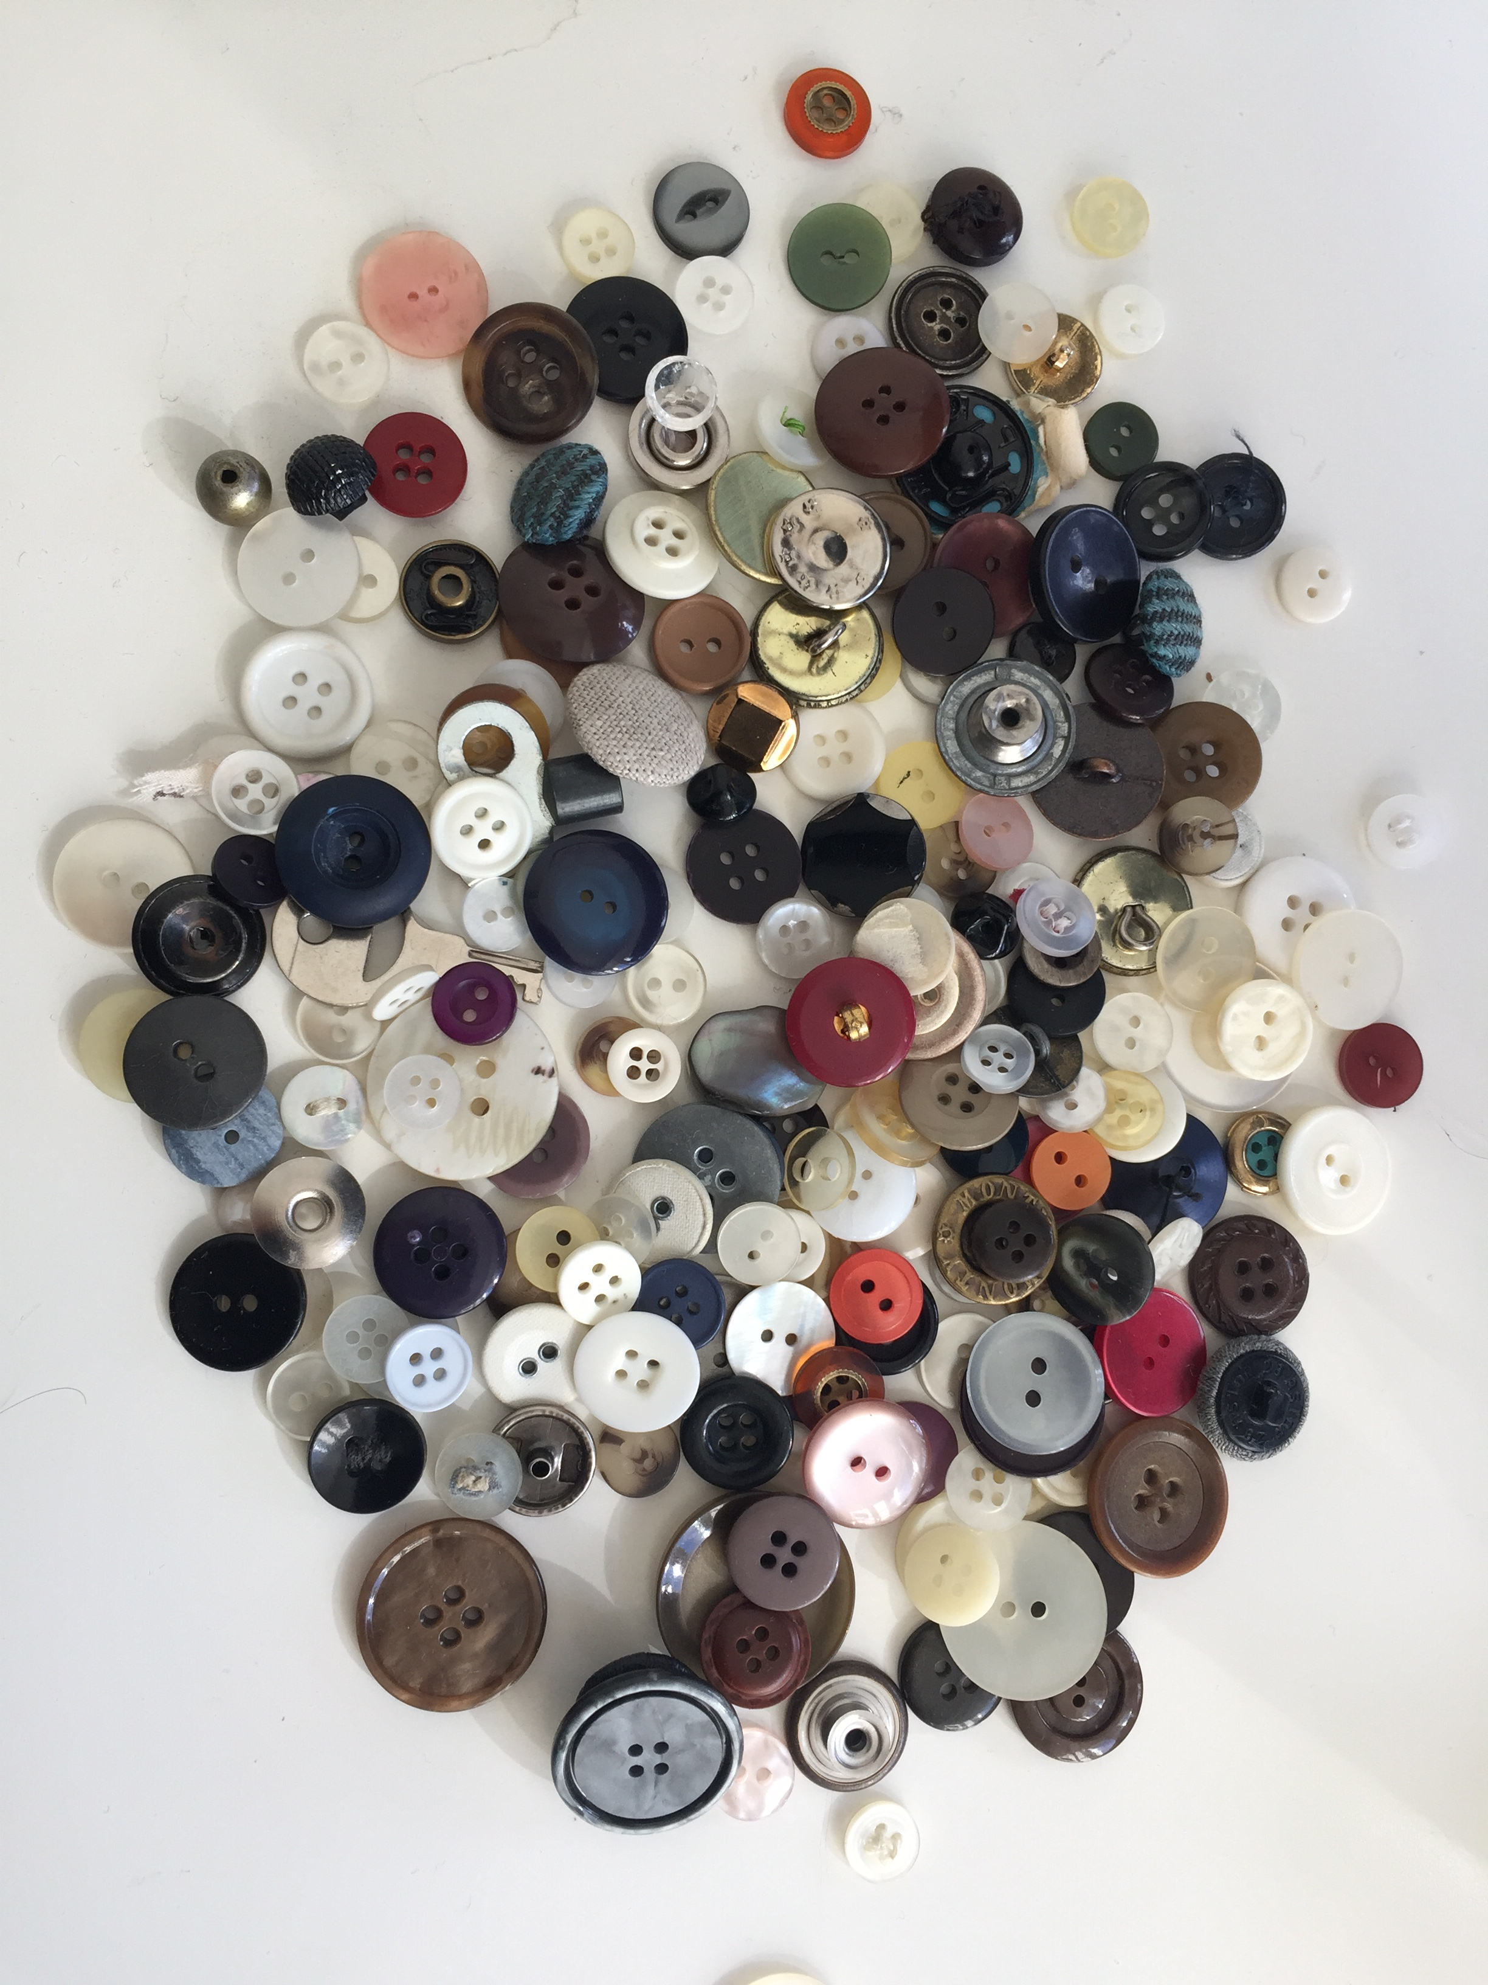
Activity 1: What themes are present in the data?
Treat the buttons as data.
What themes are present in the data?

Slide 11
Activity 1: Discussion
How did you decide which themes to code for?
Were there any buttons that posed a problem for you? How did you handle them?
What other themes could you code for that you haven’t already?

Slide 12
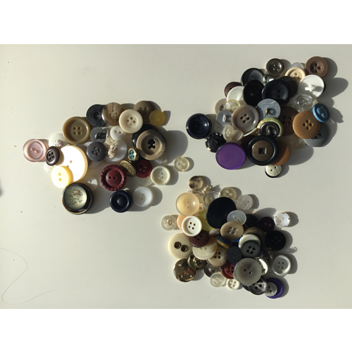
Activity 2: Relationship between dataset and characteristics
Divide your ‘data’ (buttons) into three ‘datasets’.
Think about the characteristics (e.g., colour) of the buttons and decide what characteristic you want to code for (only pick one).
Create a table on your flipchart paper with the datasets along one side and the characteristic along the other. What is the relationship between the datasets and the characteristic you are coding for?
 | Dataset 1 | Dataset 2 | Dataset 3 | ...
Characteristic category 1: _____________
Characteristic category 2: _____________
Characteristic category 3: _____________

Slide 13
Breakout 2 Discussion:
How would coding in this way be different from the first breakout?
When might this strategy be more appropriate than the strategy used in the first breakout?
When might be a situation when you might want to analyse data in this way? Why?
How might this process have looked different using actual qualitative data, like interview transcripts, for example?

Slide 14
Breakout 3: The relationship between characteristic 1 and characteristic 2
Think about two characteristics of the buttons and decide on two characteristics you would like to code for. Create a table on a new sheet of flipchart paper with characteristic 1 along one side and characteristic 2 along the other. What is the relationship between characteristic 1 and characteristic 2?
 |  | Characteristic: ____________
 |  | Category 1: _____________ | Category 1: _____________ | Category 1: _____________
Characteristic: _____________ | Category 1: _____________
 | Category 2: _____________
 | Category 3: _____________
 | Category 4: _____________

Slide 15
Breakout 3 Discussion:
How is this strategy of coding different from coding in the previous breakouts?
When might this strategy be more appropriate than the strategy used in the previous breakouts?
When might be a situation when you might want to analyse data in this way? Why?

Slide 16
Qualitative Data Analysis

Slide 17
Audio and video data can be transcribed
‘Transcription’ is the process of typing up data
Transcription allows you to get ‘close’ to your data
But it takes a long time to do (up to 6, 7, 8 hours to transcribe 1 hour of audio)
AI transcription?

Slide 18
Tips for Transcribing
Transcribe as soon as possible after collecting the data (ie. interviews/focus groups)
Open up data, get a feel for the data
Make notes of ideas as you go along (called ‘analytic memos’ (Saldaña, 2009))
Anonymous name tags
Q for question, A for answer
R for researcher, I for interviewee
Typically interviewees should not be identifiable from transcript

Slide 19
Other things to think about…
What do you do when you come to an inaudible section?
Transcribe Wreally: https://transcribe.wreally.com/
AI transcription software (must be GDPR compliant!)

Slide 20
Interview Details
Date: 14/07/08
Time: 11.00am
University: W
Duration: 33mins 29secs
Participants: W1a
Res:
Could you tell me about the management and governance structure in place at the university for dealing with environmentally sustainable estates initiatives and what is your role within that framework as environmental manager?
W1a:
Ok, well it’s just changed really, the Enviroversity program is the thing that’s trying to build sustainability into the core of the institution really, taking it out of estates where it has traditionally sat. What’s happened essentially is a series of task groups have been set up which are looking at waste and recycling, transport, energy and carbon, procurement, food and drink, mainly environmental issues but some wider sustainability issues as well. And they’re all chaired by people who are on the highest decision making board here, quite senior people. They don’t necessarily have expertise in that area but they’re there to sort of lend some weight to it and then the groups are facilitated by the people who have the most knowledge of that area, so I do the waste management and sustainable travels ones and they’re starting to be how decisions are made. Estates are still kind of working out what they’re doing with this, so if your looking at construction they’re started to think about having a task group for that but it’s not really formed properly so that still tends to happen just in the estates department at the moment.
Res:
So you are starting to link up Enviroversity with the estates department?
Example transcript

Slide 21
Qualitative analysis
Structured strategies
Analytic induction
Grounded theory
Thematic Analysis
Method
Coding

Slide 22
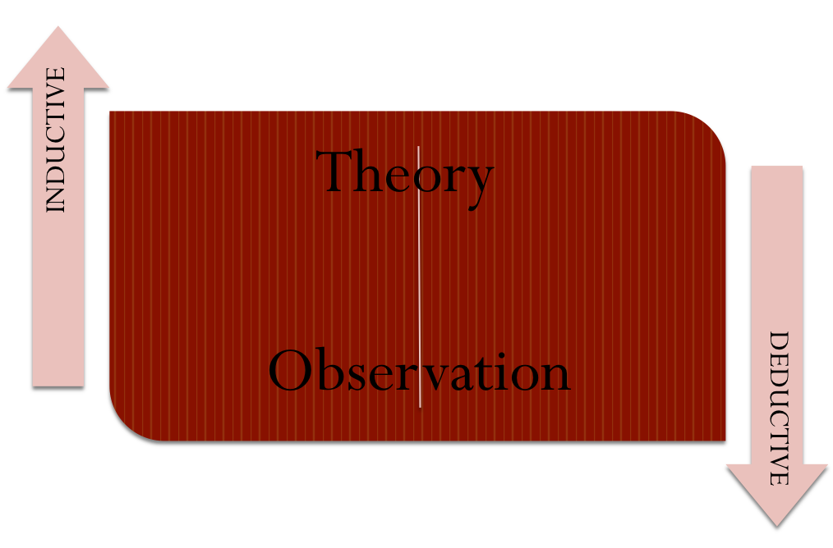
Inductive
Deductive
Creating explanations from observations
Open-ended/exploratory
Testing theories/hypotheses
Narrow focus

Slide 23
Qualitative Analysis Methods

Slide 24
Analytic Induction

Slide 25
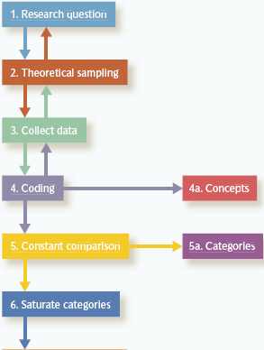
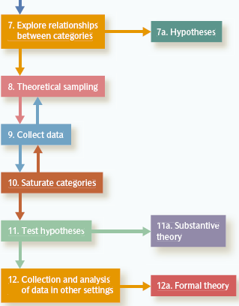
Grounded Theory

Slide 26
Thematic Analysis
The process of identifying patterns or themes in qualitative data
One of the most common approaches to qualitative data analysis
Not an approach to analysis that has an identifiable heritage or that has been outlined in terms of a distinctive cluster of techniques

Slide 27
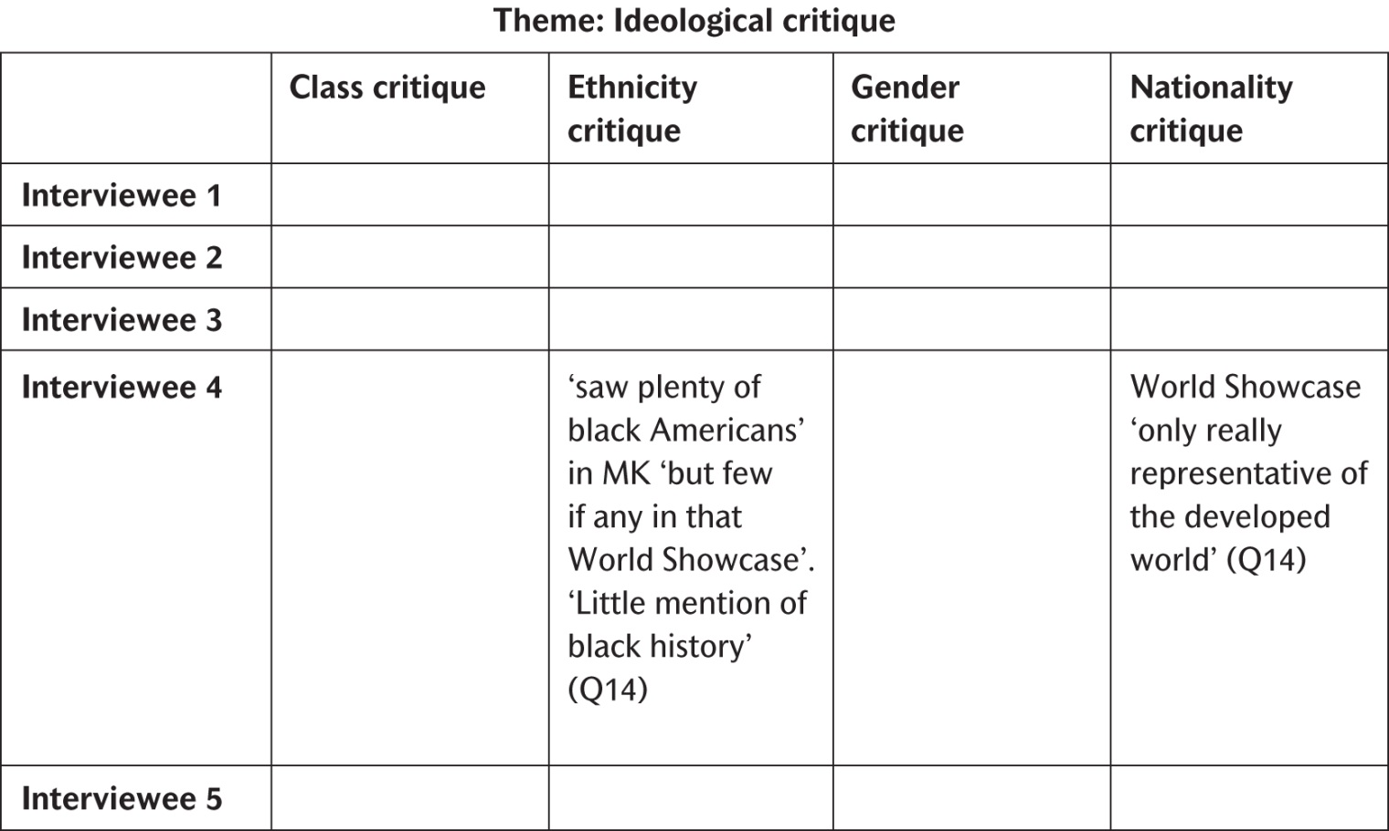
Example of Thematic Analysis

Slide 28
Coding

Slide 29
What is a code?
The process of categorising data to enable analysis
Usually a word or short phrase that symobolises data
Summarises/condenses to make it easier to manage large amounts of data

Slide 30
What does a code look like?

Slide 31
What do you code?
Anything you think might be important!
But here’s a list of questions to consider while coding:
What are people doing? What are they trying to accomplish?
How, exactly, do they do this? What specific means and/or strategies do they use?
How do members talk about, characterise, and understand what’s going on?
What assumptions are they making?
What do I see going on here? What did I learn from these notes?
Why did I include them?
What strikes me?
(Emerson et al., 2005, p.146; Saldaña, 2009, p. 18)

Slide 32
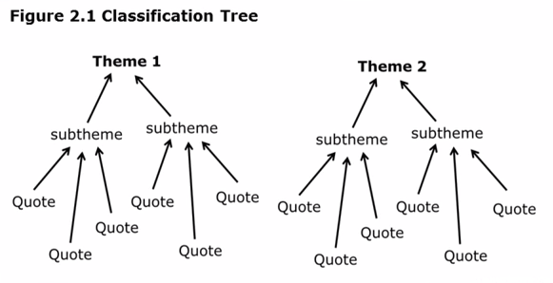

Slide 33
Lumping or Splitting?
Lumping
Splitting
Coding large chunks of text (several sentences, paragraphs)
Use when you are not sure what the codes and categories will be
Coding small pieces of text (words, phrases)
Use when you are more certain about the codes and categories

Slide 34
But what does coding look like?!
Manual Coding

Slide 35
But what does coding look like?!
Manual Coding

Slide 36
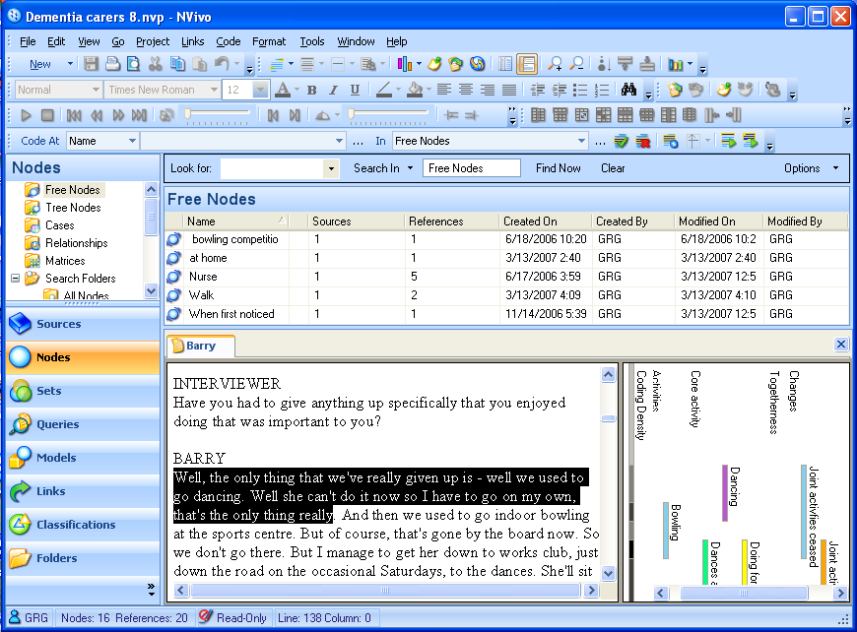
But what does coding look like?!
Manual Coding
Coding with Computer-Assisted Qualitative Data Analysis Software (CAQDAS)

Slide 37
Example of a coding process

Slide 38
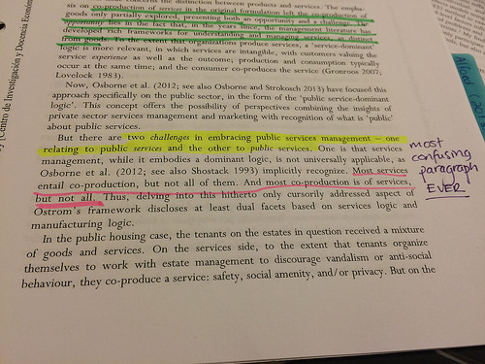
Step 1: Highlight/underline the important information and assign a code

Slide 39
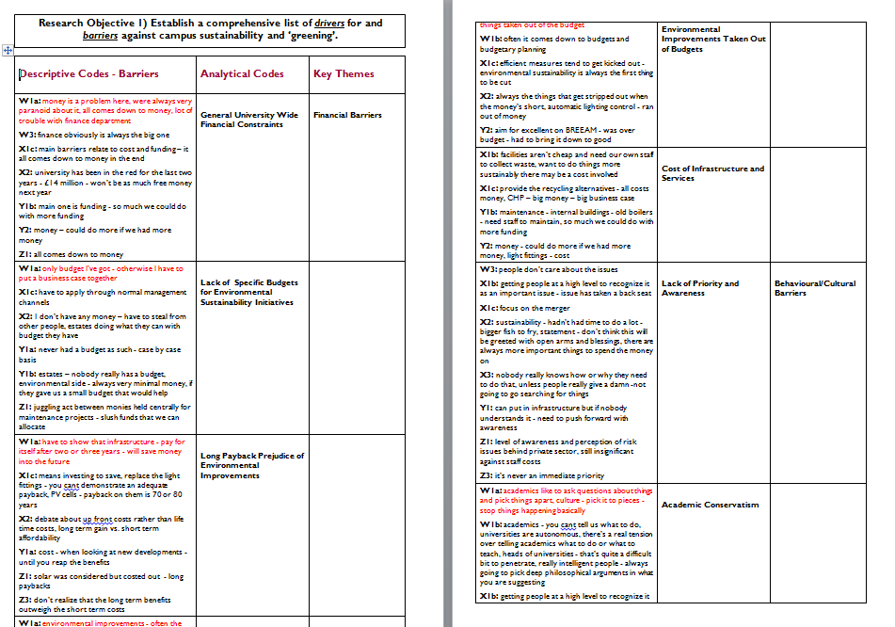
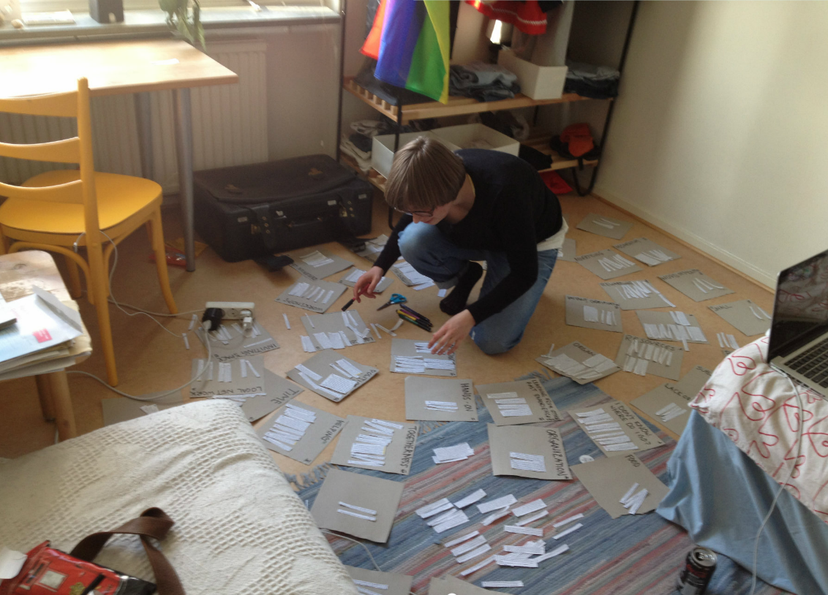
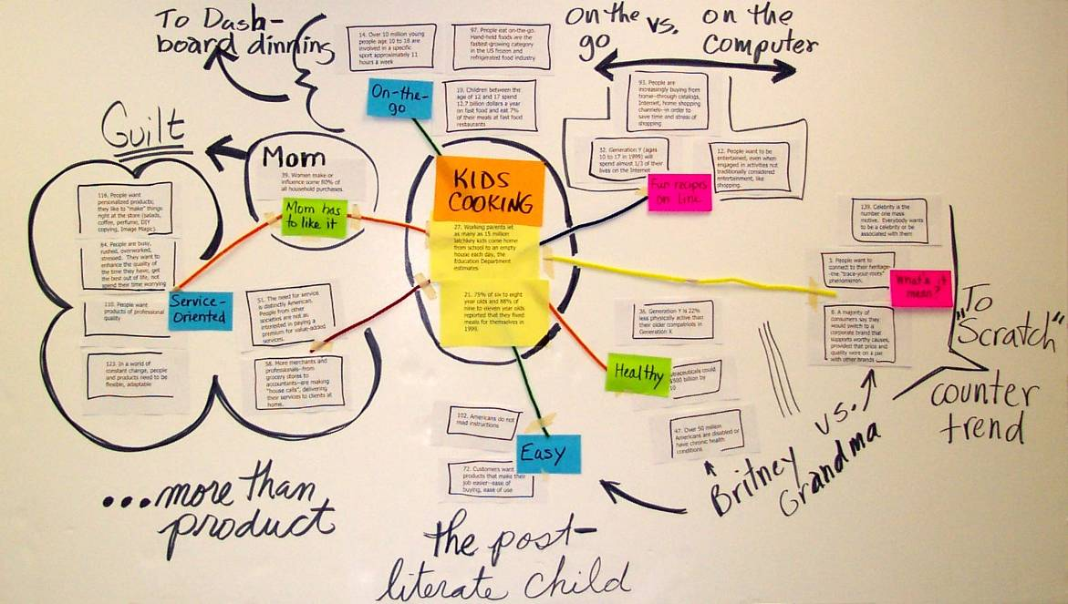
Step 2: Group sections of text/codes into themes

Slide 40
Step 3: Can these themes be grouped more? If yes, group more together

Slide 41
Step 4: Go back to the interviews – is there anything you missed?

Slide 42
Step 5: Produce a coding table and/or tree

Slide 43
Step 6: Writing up
What are the main themes you discovered?
What are your sub themes? Present them logically.
Are there any relationships between the themes? What are they?
Can you use direct quotes to support your findings?

Slide 45
Some useful tips
Don’t ignore the things that bother you – tensions, conflicting information, paradox – these are sometimes the most important things!
Write analytic memos – notes, reflections, brain dumps – these can be where you find gems
Stay focused on what you want to find out. Ask yourself every day: What do we want to find out through our research?
And then, don’t code everything! Only what is meaningful to answer your research question.

Slide 46
Breakout 4:
What do you think are the benefits of using coding as a strategy to analyse data? Why?
What do you think the weaknesses are of coding as a data analysis strategy? Why?
How do you think rigour can be built into the coding process? Why?
What measures of rigour do you think are appropriate for qualitative research? Why?

Slide 47
Questions?

Slide 48
Further reading
Saldaña, J. (2015). The coding manual for qualitative researchers. Sage.
Bryman, A. (2016). Social research methods. Oxford university press.
Savin-Baden, M., & Major, C. H. (2013). Qualitative research: The essential guide to theory and practice. Routledge.

